Slide 1

ITEM RESPONSE THEORY
Dr Oliver Clark

Slide 2
OUTCOMES
Distinguish between test theories and test models
Compare and contrast Item Response Theory and Classical Test Theory
Introduce the ‘Ability’ Score
Critically evaluate both methods

Slide 3
TEST THEORY vs TEST MODEL
Test Theory
General Framework
Provides verbal links between observable and unobservable variables
Cannot be evaluated
Test Model
Specific details
Provides mathematical definition of links between obs, unobs
Can be evaluated through model fit
Require assumptions

Slide 4
ASSUMPTIONS
Set of conditions that need to be true for the model to make sense
Limit the situations that the model can be applied to

Slide 5
WEAK vs STRONG THEORIES
Weak Theories have fewer assumptions and are therefore applicable to far more cases
For instance – omega is a weaker theory of reliability which means it is usable in more situations
Alpha is a strong theory of reliability which means it is usable in very specific situations

Slide 6
CLASSICAL TEST THEORY RECAP
True score + Error score = Observed Score
True score is the score that a candidate would get if completing on unlimited parallel tests
Error is quantified using the standard error of measurement and confidence intervals
All are theoretical elements rather than ‘models’

Slide 7
CLASSICAL TEST THEORY RECAP
Error is quantified using Standard Error of measurement using reliability and standard deviation of norm sample
Error score should not be correlated with true score
Average error across population should be 0
Error score of parallel tests are uncorrelated
All are testable/demonstrable
Assumptions

Slide 8
CLASSICAL TEST THEORY RECAP
Error is quantified using Standard Error of measurement using reliability and standard deviation of norm sample
Error score should not be correlated with true score
Average error across population should be 0
Error score of parallel tests are uncorrelated
All are testable/demonstrable
Assumptions

Slide 9
ITEM RESPONSE THEORY
Every person has an ‘Ability’ score
This ability score is unobservable
The score partly determines the probability of getting a question correct
Responses to questions are the ‘observable’ outcome; the theory assumes that ability can be inferred from these.

Slide 10
ASSUMPTIONS OF IRT
Stricter:
‘Unidimensional’ structure (this is not a requirement of CTT, bizarrely, but is a requirement of reliability models)
Each item is representable by an item characteristic curve
‘Local Independence’

Slide 11
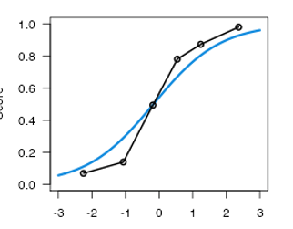
LOGISTIC MODELS
Test items are dichotomous – you get them correct or incorrect
In Classical Test Theory we add these up to create a continuous variable
In Item Response Theory we use the probability of getting an answer correct

Slide 12
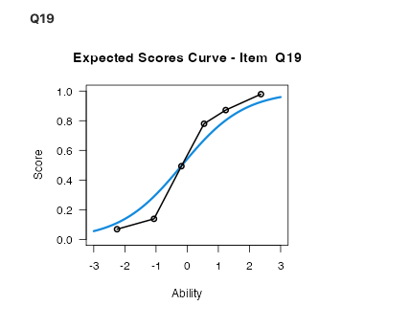
ITEM CHARACTERISTIC CURVE

Slide 13
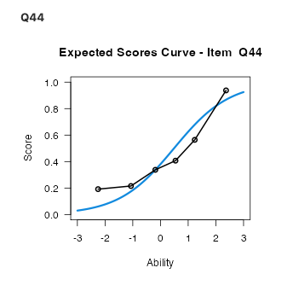
ITEM CHARACTERISTIC CURVE

Slide 14
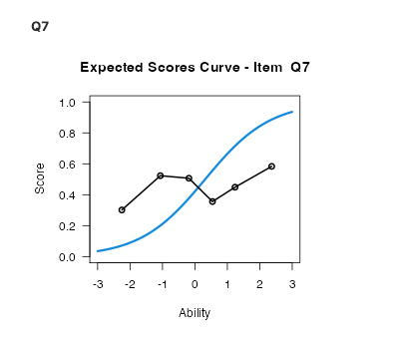
ITEM CHARACTERISTIC CURVE

Slide 15


ITEM CHARACTERISTIC CURVE

Slide 16
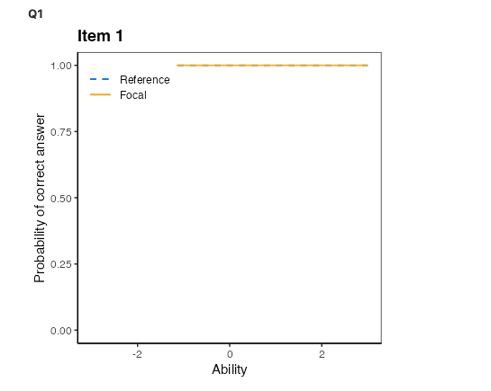
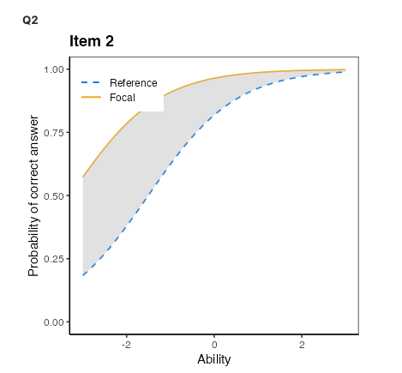
DIFFERENTIAL ITEM FUNCTION

Slide 17
INDIVIDUAL SCORES
A test yields an ability score
This falls on a standard normal distribution (mean of 0, sd of 1)
Standard Error is dependent on the level of ability; we use this to create confidence intervals
Person | Score | Ability | SE
P1 | 42 | 1.84 | 0.63
P2 | 27 | -1.18 | 0.390
P3 | 43 | 2.27 | 0.72

Slide 18
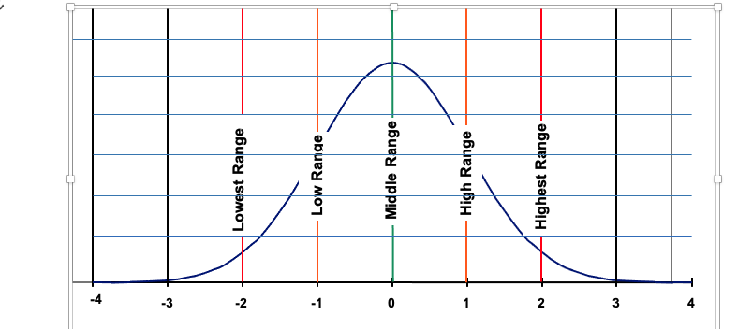
INDIVIDUAL SCORES
P2
P1
Person | Score | Ability | SE
P1 | 42 | 1.84 | 0.63
P2 | 27 | -1.18 | 0.390
P3 | 43 | 2.27 | 0.72

Slide 19
COMPUTERISED ADAPTIVE TESTING
Rather than just giving the same items to everyone (as in CTT) software can be used to adapt tests to get more accurate estimates of ability

Slide 20
SIDE BY SIDE
Classical Test theory
Item response theory
Weak assumptions
‘Test level’ analysis
Score bounded by the number of items in a test
All parameters are sample dependent
Strong assumptions
Item level analysis
Score can take any value on a standard normal distribution
Parameters are independent of sample

Slide 21
WHAT ABOUT TOOLS THAT DON’T MEASURE ABILITY?
Ability Score
Latent Variable score
Someone with higher ability is more likely to get an answer correct
Someone with higher ability is more likely to get ‘difficult’ questions correct
A person who is higher in extraversion is more likely to respond strongly to extraversion items
Someone with higher depression symptoms is more likely to report more severe symptoms

Slide 22
CONCLUSION
IRT is an item level analysis that provides estimates of latent traits
IRT makes stronger assumptions that data need to meet
It is more informative than CTT but this comes at the cost of less flexibility

Slide 23
REFERENCES
Hambleton, R. K., & Jones, R. W. (1993). Comparison of classical test theory and item response theory and their applications to test development. Educational measurement: issues and practice, 12(3), 38-47.
Reid, C. A., Kolakowsky-Hayner, S. A., Lewis, A. N., & Armstrong, A. J. (2007). Modern psychometric methodology: Applications of item response theory. Rehabilitation Counseling Bulletin, 50(3), 177-188.
Schultz, Whitney, & Zickar (2020); Measurement Theory in Action: Case Studies and Exercises (Module 20)

